Slide 1
Why Dell Servers
Customer-inspired design, industry-leading innovation, award-winning channel partner engagement
Notes:
The deck has the key objective of sharing and articulating the numerous benefits of Dell servers to our partners. Please refer to the slide notes for additional explanation of slide content.

Slide 2

Why Dell Servers
From the smallest home offices to the largest hyperscale data centers
Dell has been in the server business for nearly 20 years and has successfully evolved to become a global provider of end-to-end technology.
We are a recognized industry leader with accolades including InfoWorld’s 2014 Technology of the Year (Best Server) for the Dell PowerEdge VRTX and the top spot on CRN’s all-time list for the Dell PowerEdge R720.
We have and will continue to innovate and evolve server infrastructures based on partner and customer feedback.
Our award-winning PartnerDirect program offers successful partner engagement, program simplicity and flexibility, and a responsive and entrepreneurial approach.
Notes:
Thank you for your interest in learning more about the value of and the opportunity to grow your server business as a Dell Partner.

Slide 3




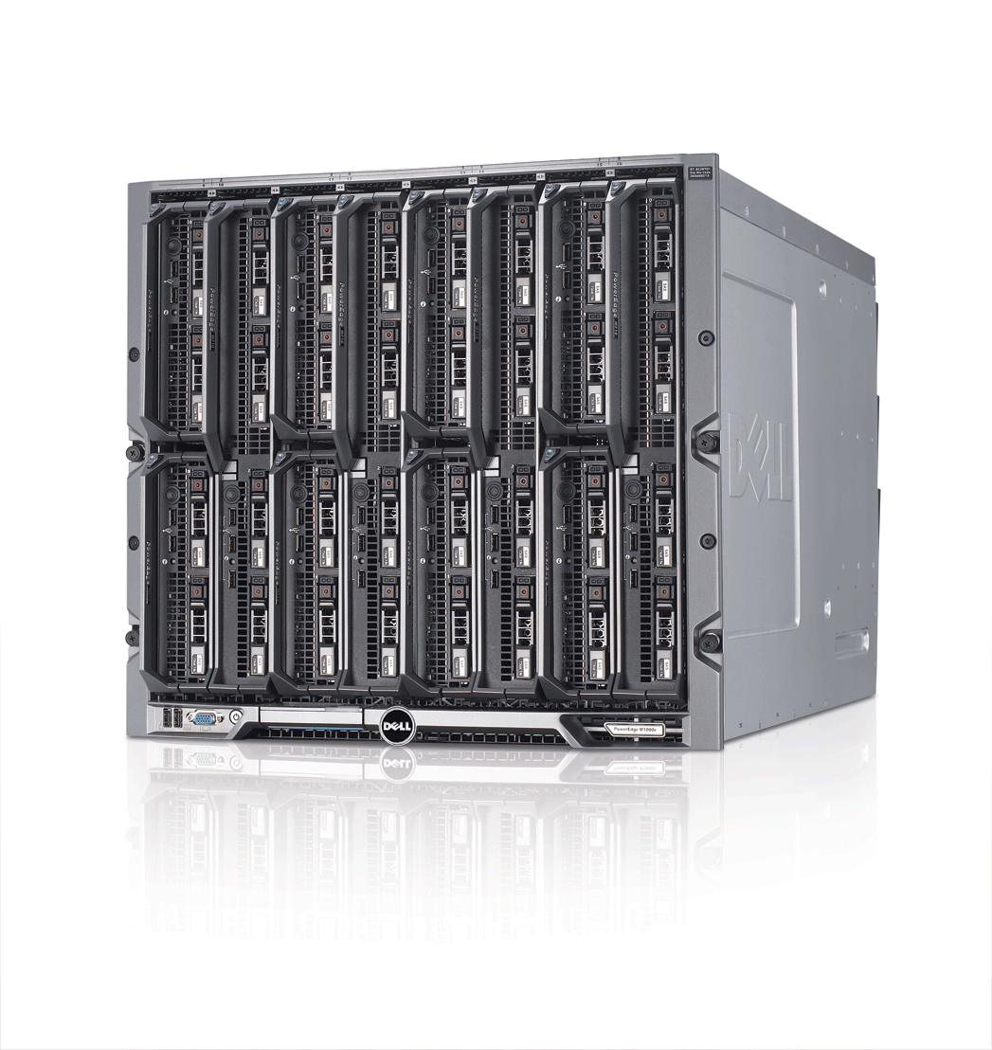






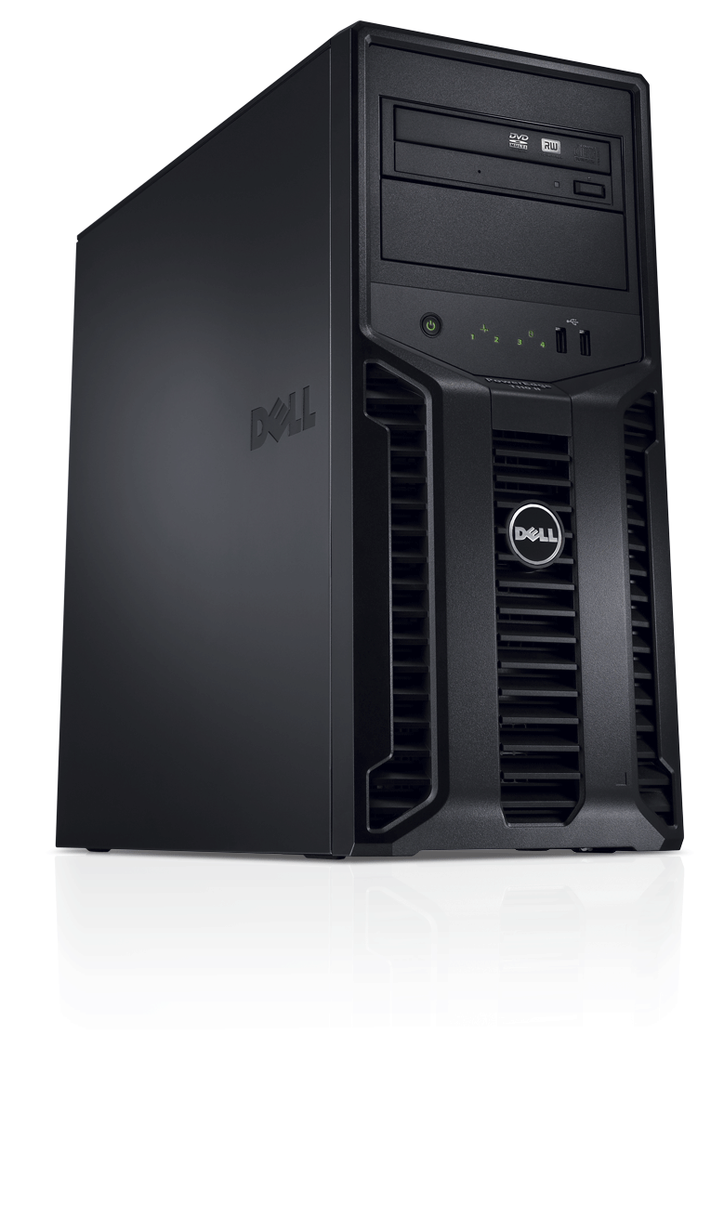





Dell PowerEdge: Server portfolio
Home office
Small business
Remote & branch offices
Small data centers
Medium to large data centers
Hyperscale¹
Shared infrastructure
PowerEdge M-Series blade servers
PowerEdge VRTX* Dense 2S/4S, storage & networking for SMB² & ROBO³
PowerEdge M420*, M520*, M620*, M820*, M915, M1000e Dense 2S to scalable 4S
PowerEdge rack-optimized servers
R210 II*
Entry 1S (1U)
R520*, R515 Mainstream 2S (2U)
R820*, R815 Dense 4S (2U)
R320* Mainstream 1S (1U)
R620* Performance 2S (1U)
R910* Highly scalable 4S (4U)
R420*, R415 Mainstream 2S (1U)
R720*, R720xd*, R715 Performance 2S (2U)
PowerEdge tower servers
PowerEdge C servers
T20*
SOHO⁴ 1S
T110 II*
Entry SMB 1S
T320* Mainstream 1S
T420* Mainstream 2S
T620* Scalable 2S
C5220*, C6015, C6145, C6220*, C8000 series* Cloud & multi-node optimized
Partners can work with Dell to create custom data solutions.
Small and medium business
Remote office/branch office
Small office/home office
*Server model powered by Intel
Notes:
Dell offers a full portfolio of PowerEdge™ servers to meet the diverse needs of your customers, regardless of their workload, from small and home offices to giant data centers. PowerEdge servers are available in tower, blade, rack and flexible installation options.
Note: Servers not identified on slide as powered by Intel use AMD processors.

Slide 4
Dell Servers Strategy
Maximize operational effectiveness
Superior customer benefit
Greater IT efficiency — Optimize costs and resource utilization for on-premises and cloud-enabled IT
Superior IT agility — Scale to meet today’s “always on, instant access” demands simply and economically
Better IT reliability — Maximize uptime to deliver results the instant they are needed
1
2
Optimize flexibility at any scale
3
Ensure worry-free computing
Notes:
Dell offers superior benefits for your customers by offering solutions with efficiency, agility and reliability.

Slide 5
Dell PowerEdge: Differentiating features
Easy to use
Agent-free monitoring
Integrated Dell Remote Access Controller 7 (iDRAC7) with Lifecycle Controller
Power profiles
Integration with Microsoft® System Center
Best alignment with application requirements
Broad product portfolio, including blades, towers, racks and hyperscale
Top performance features, including:
Dell PowerEdge Express Flash PCIe solid-state storage device (SSD)
Split drive planar for top drive performance
Dell CacheCade™
Best uptime and cost containment
Dell Fresh Air thermals
Power-monitoring accuracy and extended power range
Redundant hypervisors (Secure Digital [SD] cards)
Memory page retire
Memory configuration error notification
Flexibility to protect IT investments
Dell PowerEdge Select Network Adapters
Switch-independent network interface card (NIC) partitioning
Notes:
Flexibility to protect IT investments
Dell’s new Select Network Adapter family — a collection of modular network interface daughter cards available on our core performance systems — lets your customers choose the right integrated network without using up a valuable, additional PCI slot. They can pick between multiple speeds and technology options — such as switch-independent partitioning, which allows them to share and manage bandwidth on 10GbE connections — and even upgrade the integrated network adapter later as their needs evolve.
Easy to use
Dell has streamlined and automated the most common system administrator tasks by embedding second generation systems management technology, Integrated Dell Remote Access Controller 7 (iDRAC7) with Lifecycle Controller, into the latest generation of PowerEdge servers. The Dell OpenManage™ systems management portfolio of tools simplifies managing the server lifecycle of deployment, updates, monitoring and maintenance. Using OpenManage solutions, IT administrators can manage Dell servers in physical, virtual, local and remote environments, operating in-band or out-of-band, with or without a systems management software agent.
Best alignment with application requirements
Dell PowerEdge offers a broad product portfolio, including blades, towers, racks and hyperscale configurations. With the addition of Dell Express Flash PCIe SSDs to the PowerEdge lineup — a front-accessible and hot-pluggable PCIe SSD technology — as well as increased internal storage capabilities on the new PowerEdge rack and tower servers, your customers now have more storage technologies, options and capacities to choose from than ever before. They can even boost RAID performance further with Dell CacheCade™, which provides the ability to use SSDs as an expanded cache for enhanced throughput.
Best uptime and cost containment
The latest PowerEdge servers also offer greater efficiency in terms of power and energy with many platforms offering class-leading or industry-leading performance per watt — every component is optimized for the most efficient operation. With Dell Fresh Air, PowerEdge servers are engineered for minimum power consumption and optimized to run at higher operating temperatures. Dell PowerEdge servers also keep your customers’ data centers running reliably with redundant failsafe hypervisors for virtualization environments, memory page retire and memory configuration error notifications.

Slide 6
PowerEdge servers: industry-leading innovation
Dell PowerEdge R720 provides the world’s best two-processor Linux® SAP® SD performance.¹
Dell PowerEdge R720 is the world’s most power-efficient server.⁴
Dell PowerEdge R720 is the world’s most power-efficient rack server.²
Dell PowerEdge M620 is the world’s most power-efficient blade server.³
Deploy virtualized infrastructure on the world’s most reliable VMware platforms, using Dell Fault Resilient Memory and redundant embedded hypervisors.⁵
Notes:
Results of the Dell PowerEdge R720 on the two-tier SAP SD standard application benchmark: 9,900 SAP SD benchmark users with the SAP enhancement package 5 for SAP ERP 6.0, Red Hat® Enterprise Linux 6.4 and Sybase® Adaptive Server Enterprise (ASE) 15.7; two Intel® Xeon® E5-2697 v2 processors (24 cores, 48 threads); and 256GB main memory. Certification number 2013031. Results of the HP® ProLiant® DL380p Gen8 on the two-tier SAP SD standard application benchmark: 9,815 SAP SD benchmark users with the SAP enhancement package 5 for SAP ERP 6.0, Red Hat Enterprise Linux 6.4, and Sybase ASE 15.7; two Intel Xeon E5-2697 v2 processors (24 cores, 48 threads); and 256 GB main memory. Certification number 2013029. Results as of October 23, 2013. For more details, visit sap.com/benchmark
Dell PowerEdge R720 achieved a SPECpower_ssj2008 result of 8,458 overall ssj_ops/watt which is higher than all published SPEC power results for rack servers as of October 2, 2013. SPEC® and the benchmark name SPECpower_ssj® are trademarks of the Standard Performance Evaluation Corporation.
A chassis full of Dell PowerEdge M620 blade servers achieves up to 25 percent higher performance/watt ratio than a chassis full of Dell PowerEdge C5220 blade servers. The 16-node Dell PowerEdge M620 achieved a SPECpower_ssj2008 result of 7,525 overall ssj_ops/watt, compared to the 16-node Dell PowerEdge C5220 with a SPECpower_ssj2008 result of 6,000 overall ssj_ops/watt score.
Dell PowerEdge R720 achieved a SPECpower_ssj2008 result of 8,458 overall ssj_ops/Watt which is higher than all published SPECpower results for rack servers as of October 2, 2013
Database performance and memory capacity with the Intel Xeon processor e5-2660 v2 powered Dell PowerEdge M620, based on Principled Technologies Test Report commissioned by Dell, July 2013. For more information, visit principledtechnologies.com/Dell/PowerEdge_E5-2600v2_FRM_0813.pdf

Slide 7
What’s in it for you?
Market validation for Dell PowerEdge servers
Achieve more: Turn your customers' business workloads into engines for growth.
Protect your customers' investment by providing a flexible IT architecture.
Enable your customers to access information faster for insightful decisions.
Deliver real results faster: Accelerate time to value via end-to-end workload solutions.
Simplify lifecycle management of your customers’ IT infrastructure.
Automate your customers’ IT tasks to improve administrative efficiency.
Maximize efficiency: Provide resilient infrastructure to maximize uptime.
Provide better control of energy consumption to minimize your customers’ total cost of ownership (TCO).
Enable your customers with secure, reliable access to valuable information.
Better together solutions: Deliver even greater performance when paired with Dell storage solutions.
Sell Dell PowerEdge servers with Dell storage and leading original equipment manufacturer (OEM) connectivity.
5 Reasons to sell Dell PowerEdge servers
Increased margins
Comprehensive training program
Participation in available partner promotions, rebates and lead generation
Easy-to-access sales tools and supporting customer materials
Notes:
Partner and profit with Dell server solutions. Your customers will thank you for it.

Slide 8
Where to go from here
Login to the Partner Portal to access numerous PowerEdge sales and marketing assets.
Earn server competency or train even more sales and technical staff.
Sell Dell’s end-to-end solution
Benefit from this exciting time at Dell
Help enable your customers to:
Turn data into insights
Overcome evolving security threats & ensure compliance
Accelerate adoption: virtualization, convergence, cloud
Notes:
Thank you for your time today to learn more about Dell’s commitment to our channel partners and why Dell PowerEdge servers are the right choice for your customers, regardless of their size or workload requirements. We hope that you are excited to continue your journey with us as a valued Dell Partner. Contact your Dell account representative for more information.

Slide 9
声明：
所有的版权属于原有公司，文件均来自公开渠道
此文件仅供学习使用，任何人不得进行以此为商业目的的行为
如有疑问，请立即删除
学习世界五百强和咨询公司PPT课程请访问如下网站搜索：“司马懿”
百度传课：司马懿PPT学校
网易学堂：司马懿PPT学校
知乎： 司马懿PPT学校
访问地址
https://www.chuanke.com
访问地址
https://study.163.com
访问地址
https://www.zhiu.com

